Slide 1
RAATS Testing Strategies FOR STAAR TEST
Oh! RAATS!!!
By: Mr. R. Benavides – Social Studies teacher
Modified for Reading by J. Guzman
Oh! RAATS!
Oh! RAATS!

Slide 2
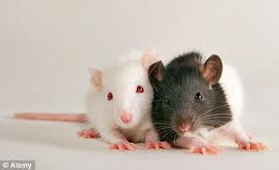
RAATS Strategies
R: READ, RETELL, RECORD
A: ACADEMIC VOCABULARY
A: ANALYZE
T: TIME
S: Strategize: Synthesize & Solve

Slide 3
READ, RETELL, RECORD
R
R
READ: Read carefully, with emotions, and visualize, as if the reading selection was a movie or cartoon. Never read for speed, read for comprehension!!
RETELL: RETELL the most important parts of what you read. For a Fiction work, summarize using a PLOT diagram. For Nonfiction: Who, what, when, where, why, and how. For Poetry: determine the TONE and THEME.
RECORD: Record important ideas in the margin. Use phrases, metacognitive markers, or simply draw it!
R
R
+, ?, !, *, LOL, WOW

Slide 4
ACADEMIC VOCABULARY
a
a
Academic Vocabulary: Highlight all academic vocabulary words. Circle any words you do NOT know. Apply vocabulary strategies when determining the meaning of any “unknown” words. Find context clues, prefixes, suffixes, and root words to determine the meaning of unknown words.
Does it sound..
….like anything in Spanish?
….like a good or bad word?
…like a person, place or thing?
…like an action?
…like a description?
…familiar – have you heard it before?
a
A
A
a
a
A

Slide 5
ANALYZE
A
A
A
Analyze: Be a great detective! Read between the lines! Look for all the clues / evidence!!
How does the setting influence the conflict in the story?
Why does the author include paragraphs 2 and 3?
What is the best summary of the selection?
THESE QUESTIONS WILL BE ASKED! ARE YOU READY FOR THEM?
And Make Connections
What do I already know about this topic?
What prior knowledge do I have about this?
Who or what does this remind me of?
Great detectives find all the evidence!!
A
A
A

Slide 6
TIME
T
T
Time: Keep track of time. Remember that the STAAR test is a timed test. You have 4 hours to work and finish the test. It’s important NOT to rush, but don’t waste time. Bubble in your answer document along as you work on your test or before time runs out. Wear a watch!!
Si se puede!
Andale! You can do this!

Slide 7
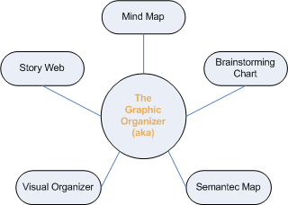
STRATEGIZE
STRATEGIZE: Use any testing strategies that you learned through out the year(s).
SYNTHESIZE: Use Blank spaces in your test to draw graphic organizers.
JOT DOWN ALL YOUR IDEAS
SOLVE: Use Process of Elimination to Solve and answer every single question on the STAAR TEST. Check ALL the answer choices. Check your answer document.
REMEMBER – STAAR IS about the BEST answer not just a good answer so check each of the answer choices carefully!
GOOD LUCK and BE CONFIDENT!!

Slide 8
Remember your RAATS Strategies
R: READ, RETELL, RECORD
A: ACADEMIC VOCABULARY
A: ANALYZE
T: TIME
S: Strategize: Synthesize & Solve
USE YOUR RAATS STRATEGIES FOR STAAR SUCCESS

Slide 9
RAATS!

