Slide 1
Determining Importance & Summarizing?
How Should We Teach
1
Notes:
Say: How should we teach Determining Importance & Summarizing? Today we want to think about ways to make our instruction more effective.

Slide 2
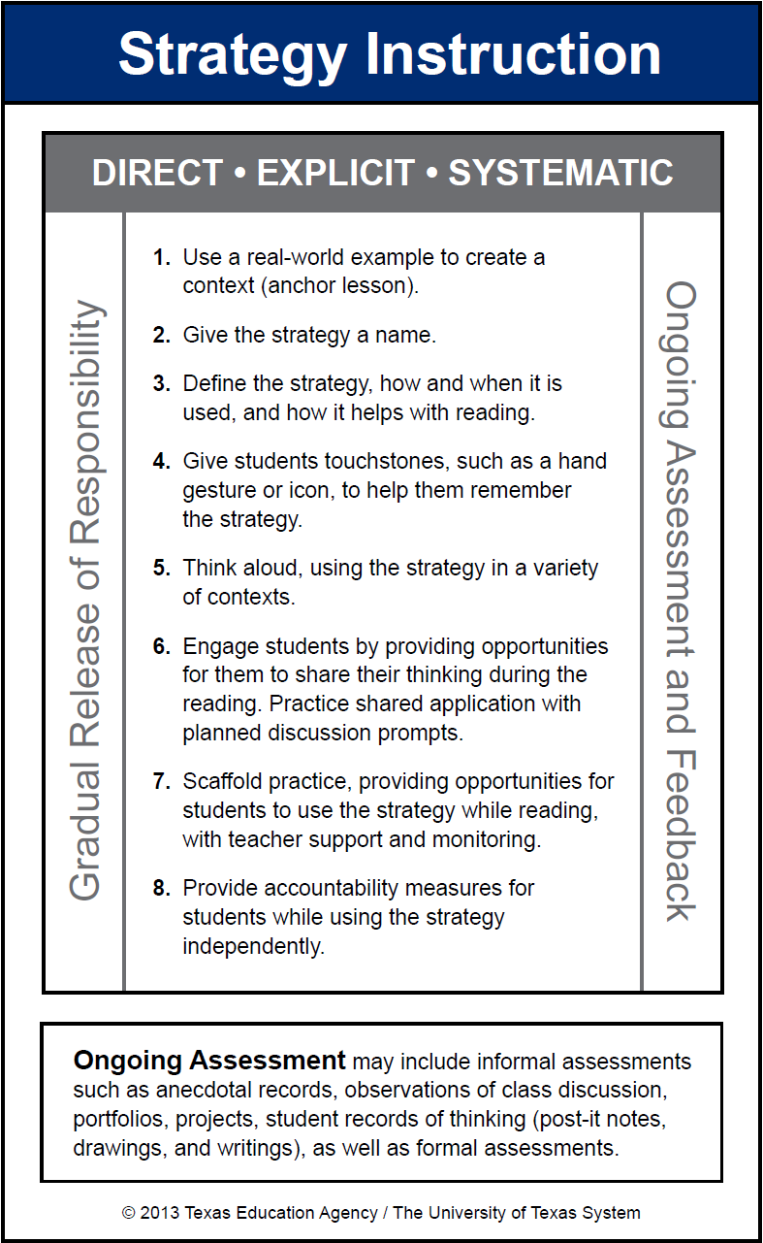
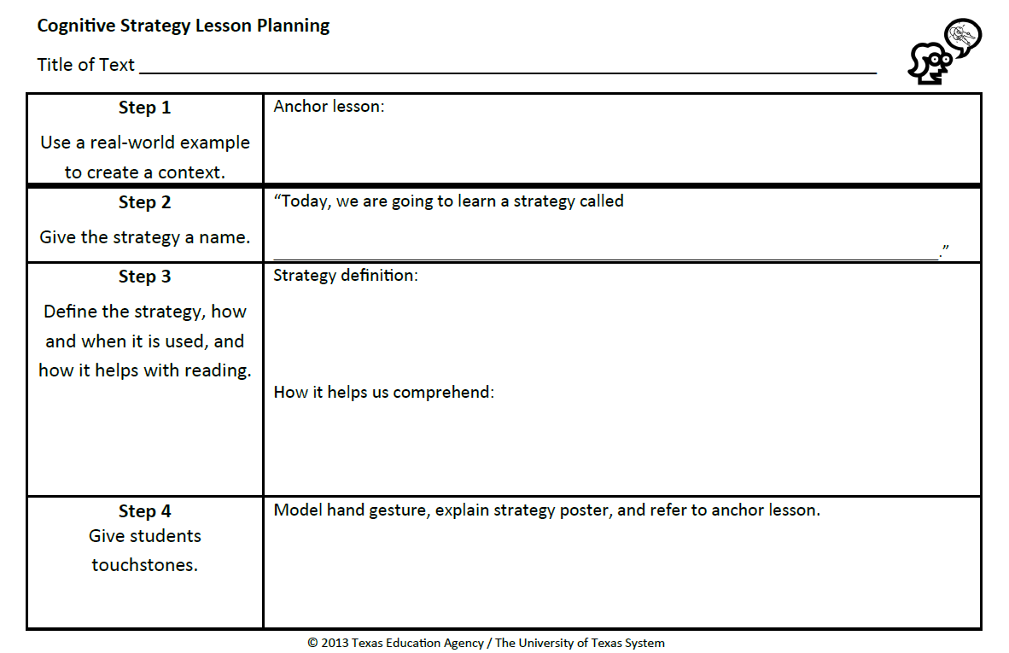
Cognitive Strategy Routine
2
Notes:
Say: As with all of our cognitive strategies, we want to teach Determining Importance and Summarizing to our students in a direct, explicit, and systematic manner. We use our 8-Step Cognitive Strategy Routine.
This routine is important because it scaffolds the learning for our students by keeping our instruction consistent. Please take out your blue and white Cognitive Strategy Routine Card so that you can follow along as I model the steps. You can also take out your Determining Importance and Summarizing Lesson Planning Card because we will be using that shortly as well.

Slide 3
Begin With an Anchor Lesson (Step 1)
An anchor lesson is a real-world example used to create context for a cognitive strategy.
It is useful to create a different anchor lesson for each cognitive strategy.
We refer to the anchor lesson to remind students of the cognitive strategy.
Learning is more consistent for students when the same anchor lesson is used within and across grade levels.
Notes:
Say: We begin all strategy instruction the same way – with Step 1, using a real-world example to create a context for the strategy. This step is important because cognitive strategies are just that – cognitive. That means that they happen in our heads, which makes it hard for students to see or understand what we are talking about. For many of our students, these cognitive strategies are abstract concepts. A real-world example helps students to realize what the strategy is, and that they already use it in their everyday lives. It is important that we know our students well and are familiar with their backgrounds and interests so we can choose examples that will have meaning to them.
Read slide.
Say: Let me share an example of an anchor lesson that could be used for Determining Importance and Summarizing.

Slide 4
Introduce the Strategy (Step 1)
4 years old
Eats Purina One food
Blue collar
Favorite toy is a stuffed squirrel
Likes kids
Last seen at school playground
Has a tag labeled Sonny
Wags his tail a LOT!
Likes to cuddle
Likes to hide in small places
Knows how to sit, stay, and lie down
Has ridden on a plane five times
Smallest puppy in the litter
Anchor Lesson
4
Notes:
Say: In our anchor lesson for determining importance, we ask students to help us create a poster for a lost dog, sifting through general information about the dog to decide what a passer-by would need to know if they were looking for the dog.
Sample Script: Class, this is a picture of my friend’s dog Sonny. My friend and I need your help. Sonny is lost. We need to make a lost dog poster that we can put on the mailboxes in my friend’s neighborhood to let everyone know that we are looking for Sonny. To help us make the poster, my friend made a long list of all the things she could think of about Sonny.
After the class had read the list together, I might go on to say:
Sample Script: There is a lot of information on this list. I don’t think all of it will fit on a poster. It will also be hard for someone to remember so much. What information is most important for people to know about Sonny so that they can help us find him? Let’s read the list one more time, and this time, let’s think about what information is important to include on the lost dog poster. We can get rid of the ideas we don’t think will be important for finding Sonny.
Reread the first bullet on the slide.
Sample Script: Four years old. Sonny is a little dog. Little dogs always look young to me even if they are ten years old. I don’t think it’s important for anyone to know how old Sonny is. That information isn’t going to help someone find her so I’m not going to include this on my poster.
Continue modeling your thinking for two or three more bullets. Explicitly explain which information is important and why you think it is important.
NOTE lines will disappear as you click through this slide.
Say: After I have modeled some of my thinking, I would ask my students to participate with me, using Think-Turn-Talk or thumbs-up/thumbs-down so they might indicate what they think is important.

Slide 5
Introduce the Strategy (Step 1)
Handout
2
Lost Dog
Blue collar
Has a tag labeled Sonny
Last seen at school playground
Likes to hide in small places
REWARD
Please Call 713-500-0000
5
Notes:
Say: Once we have created our poster, I would say to my students:
When we read, authors give us lots of information – sometimes too much for us to remember. Good readers determine what information is important to know and to remember, just like we did when making this lost dog poster.

Slide 6
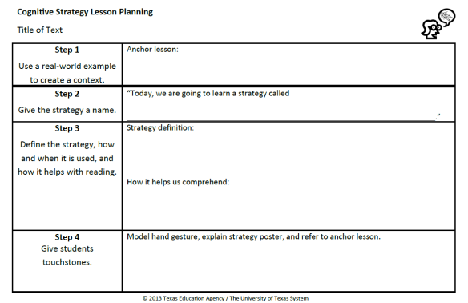
Introducing the Strategy (Step 1)
Record what you will do for Step 1 on your orange Cognitive Strategy Routine Lesson Planning Card.
Notes:
Say: Now it is your turn to think about Step 1. You may choose to introduce Determining Importance and Summarizing to students by using the example of the lost dog. If you choose to use another anchor lesson, be sure to think about your students’ background knowledge. Whatever you choose to do should be familiar, or something to which your students will be able to relate.
Take a moment to discuss with the colleagues at your table what you think you will say for your Step 1. Record what you will say on the orange Lesson Planning Card. You have a Vis-à-vis and a Sharpie in your supply pouch that you can use to write with.
You may need to return to this at a later time. It takes a lot of thought to come up with a really memorable, and effective anchor lesson.
Allow time for participants to complete.

Slide 7
7
Notes:
Say: An anchor lesson is our introduction to the strategy. Steps 2-7 are how we teach the strategy. What we plan to say and do for the next 3 steps will be repeated EVERY time we teach this strategy. In other words, we do these 3 steps before every think-aloud and every shared practice opportunity.

Slide 8
Teaching the Strategy Give the Strategy a Name (Step 2)
“Today, we’re going to talk about a strategy called Determining Importance & Summarizing.”
Record what you will say for Step 2 on your orange Cognitive Strategy Routine Lesson Planning Card.
Notes:
Say: Step 2 is, “Give the strategy a name.” We want to use clear and consistent language when referring to the cognitive strategies. Our comprehension strategy instruction is stronger if everyone in the district uses the same vocabulary to refer to the strategies we are teaching.
Read slide.
Allow time for participants to complete.

Slide 9
Teaching the Strategy (Step 3)
“Have you ever noticed how difficult it is to remember everything that you read?... Our brains just can’t seem to hold all of that information at the same time.” To help us, we need to determine importance and summarize information. In order to summarize, we must be able to identify the topic and main ideas of text, and then, we need to put that information together in our own words as briefly as possible. When we do this, we understand and remember informational text better.
(McGregor, 2007, p. 81)
Notes:
Say: Step 3 is where we define the strategy and explain how and when it is used and how it helps with reading. For example, we might say …
Read slide.

Slide 10
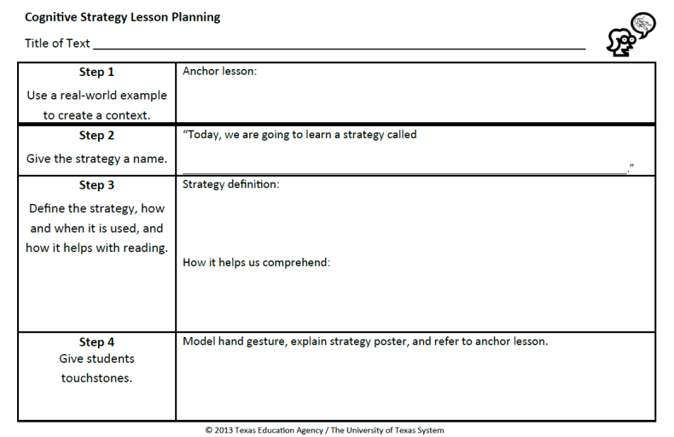
Define the Strategy (Step 3)
Record what you will say for Step 3 on your orange Cognitive Strategy Routine Lesson Planning Card.
Determining Importance & Summarizing is…
10
Notes:
Read slide.
Allow time for participants to complete.

Slide 11
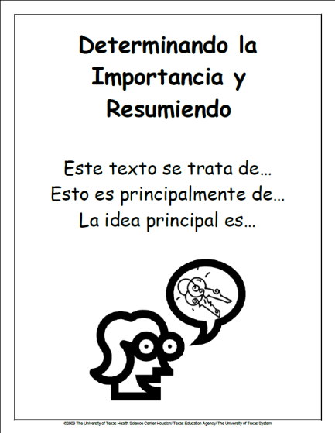
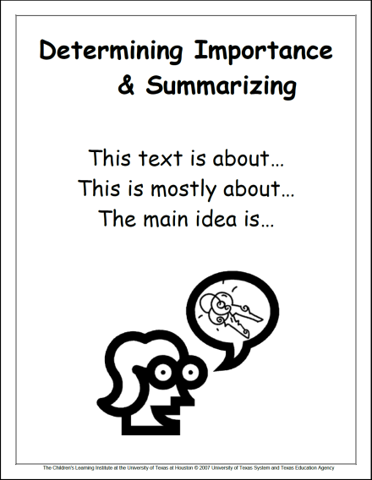
Give Students Touchstones (Step 4)
You may choose to provide students with a hand motion that signals Determining Importance & Summarizing.
Display strategy posters in the classroom.
11
Notes:
Say: To make the strategy more explicit for our students, we give them touchstones that will help them remember and understand a strategy. I have a kinesthetic hand motion, a visual icon with words for support, and the anchor lesson as a common experience. I want my students to value these touchstones, so I explicitly explain to them what the hand signal and graphic represent.
For example, I might say something like this …
Click to next slide.

Slide 12
Give Students Touchstones (Step 4)
Remember when we made our lost dog poster? We had a long list of details about the dog. Pretend that all of my fingers are those details. We didn’t want to put all of those details on our poster, we had to figure out which information was the most important – like my thumb here. The unimportant details can hide behind my hand, so that only the most important or key information is left. You will know when I am Determining Importance while reading, because I will show you this thumbs-up hand signal. When we look at our poster, you can see a lady talking. She is telling only the “key” ideas, or important information.”
12
Notes:
Read slide.

Slide 13
Give Students Touchstones (Step 4)
Record what you will say for Step 4 on your orange Cognitive Strategy Routine Lesson Planning Card.
13
Notes:
Say: Work with others at your table. How will you explain the touchstones to your students?
Read slide.
Allow time for participants to complete.

Slide 14
Think-Aloud (Step 5)
“A think-aloud is a way to provide instruction rather than just give instructions.”
(Daniels & Zemelman, 2004, p. 238).
14
Notes:
Say: Now that we’ve introduced the strategy, how do we actually teach students to determine importance and summarize? Step 5 of the Cognitive Strategy Routine is where the teacher models for students using the strategy through a think-aloud. Remember this quote?
Read the quote on the slide.
Say: This is really the critical piece of our instruction and yet, it is the one step that often gets left behind.
What we need to think about now, is what do we include in think-aloud lessons when teaching students to determine importance and summarize? Well, as you might expect, the answer is fairly complex. In order for students to summarize effectively, we need to teach them about the components they will need to include in a summary. To be explicitly clear, the first thing we need to clarify, is what we mean by the terms topic, main idea and summary.

Slide 15
To Be Continued…..

