Slide 1

Graphophonemic Knowledge:
Spelling and Dispelling
1
Notes:
Say: Welcome to today’s presentation, “Graphophonemic Knowledge: Routines and Teaching Tools.” Before we begin, let’s take care of a few housekeeping chores.
Introductions
Agenda, schedule for the day
Here are all the items you will need for this session. At registration you received a supply pouch and TEKS Handbook.
At your place setting you should find:
3-slides per page PowerPoint Handout
Additional Handouts
GK routines and Teaching Tools Booklet
Spelling Lesson Planning Card (blue)

Slide 2

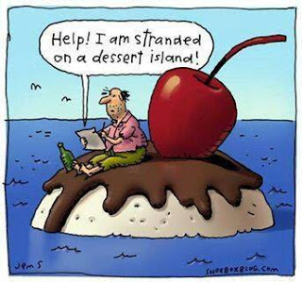

Slide 3

Share Successes
HO 1
If you have attempted to implement the spelling routine introduced at the last training:
  what has worked for you and your students?
  what is the easiest part of the routine?
  what is the most difficult part of the routine?
  what questions do you have about the routine?
  Please record your questions and be ready to share.
THINK
TURN
TALK

Slide 4
Questions?
Answers to these questions will be discussed, either in this training or through a subsequent training.

Slide 5
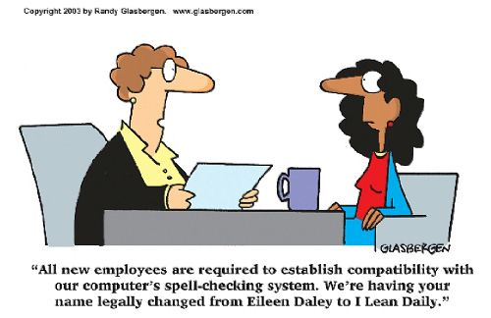

Slide 6
Let’s take a closer look at the steps in the GK routine!

Slide 7
Incorporating a Routine to Build
Student Spelling Skills
      direct instruction
+
phonics activity
+
    daily dictation
=
An effective spelling routine!
A
It’s as easy as. . .
B
C
Notes:
Say: The routine that we want to incorporate into our current instruction includes direct instruction, phonics activities, and dictation.

Slide 8
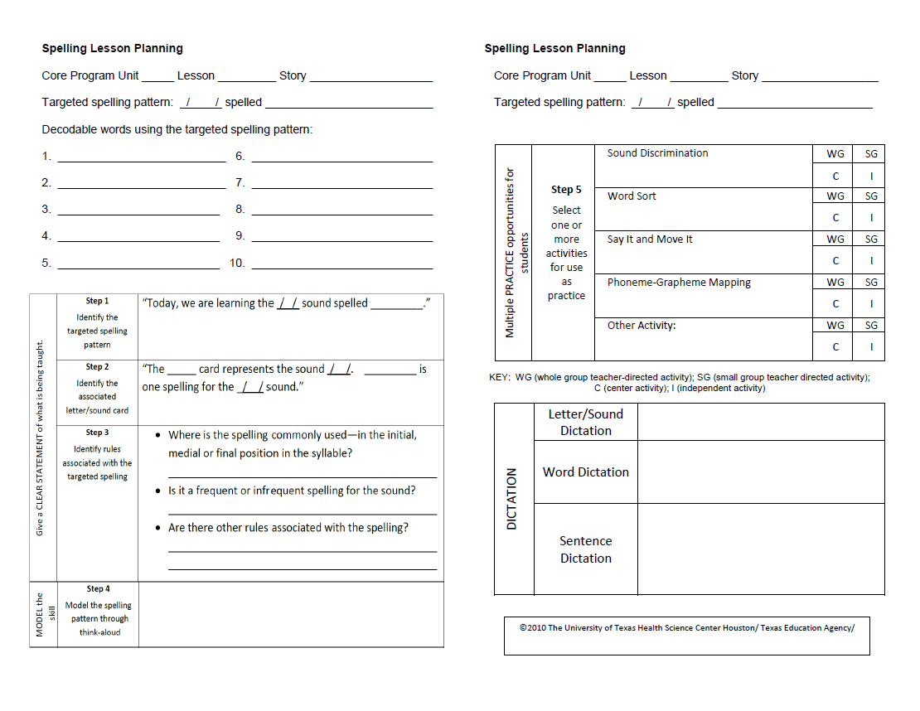
Unit/Lesson #
Spelling Pattern
Words using the pattern—you will need to come up with more for the activities!
Direct Instruction—Use these notes to teach and reteach the pattern daily.
Jot notes here for a think-aloud to model using the spelling pattern. You will think-aloud a different word each day!

Slide 9
Unit/Lesson # (reminder)
Spelling Pattern (reminder)
Notes on each activity you plan to use during the week—ONE ACTIVITY DAILY! You may use some activities more than once, and others may not be applicable to the lesson.
CHOOSE WISELY.
Jot words/ sentences to be used in dictation. DO DICTATION DAILY!

Slide 10
How long does the routine take?
Direct instruction, including think-aloud:
  3-5 minutes (reviews take a little less time)
  ONE phonics activity (whole group):
  5-7 minutes
  SHORT dictation—5 minutes
    5 letter-sounds
    2 letter-sounds, one word
    five words
    3 words, one sentence
15 minutes daily
depends on the level
of your students

Slide 11
Possible options
 | WHOLE Group | SMALL Group | CENTER Activity | HOMEWORK
1 | D.I.—5 min. Activity (1)—5 min. Dictation—5 min. | Review new spelling pattern as needed during reading groups | n/a | n/a
2 | D.I.—5 min. Activity (1)—5 min. | Dictation—5 min. (words/sentences differ acc. to students) | Spelling center: visual word sort | n/a
3 | D.I.—5 min. Activity (1)—5 min. | Dictation—5 min.—done at beginning of WRITING block | PA Center: phoneme sort Spelling center: spelling pattern hunt | Find five words (from magazine, newspaper, etc.) containing the new spelling pattern

Slide 12
How do I choose the pattern to teach?
Kindergarten
  Look at your TPRI data for PA and GK.
  Look at the Journeys/Senderos scope and sequence for PA/GK.
  First grade
    Look at your TPRI data for PA and GK.
    Look at the Journeys/Senderos scope and sequence for PA/GK/Spelling.

Slide 13
How do I choose the pattern to teach?
Second Grade
  Look at your TPRI data for PA and GK.
  Use the TPRI Spelling Error Analysis sheet (in your kit) to analyze students spelling errors and group students.
  Look at the Journeys/Senderos scope and sequence for PA/GK/Spelling.

Slide 14

How do I choose the pattern to teach?
Examine the scope and sequence from Journeys.
Let’s work together for a few minutes to figure out where you’ve been, where you are, and where you need to go.

Slide 15
Incorporating spelling into workstations
Use the same spelling philosophy!
  Once students can independently play FCRR and TPRI games and activities done in whole and small group, move these to centers.
  Word sorts make great centers! Compare/contrast words that use spelling patterns students have learned.
    closed sorts
    open sorts

Slide 16
Incorporating spelling into workstations
Keep it simple!
  Change out the spelling pattern, NOT the activity!
    Students look through newspapers and magazines to find and copy or cut out words containing the current (or a past) spelling pattern.
    Students take turns reading/spelling words. One student reads a word using the current spelling pattern. The other student sounds out and spells the word (using pencil/paper OR magnetic letters).

Slide 17
Incorporating spelling into workstations
Use spelling words at the reading/fluency center.
  Write sentences using words with the new spelling pattern. At a fluency center, students read the sentences, circle the words with the new spelling pattern, then cover the word and try to sound it out and spell it correctly. They check their own spelling by looking back at the circled word.

Slide 18
Incorporating spelling into workstations
For High Frequency Words/Sight Words, use activities to help students memorize the words.
  Write each word three times.
  Use each word in a sentence.
  Create a word jumble or crossword puzzle with the HFWs.

Slide 19
Your turn!
HO 2
Work with your assigned team.
Use the supplies on your table.
Come up with two new workstation activities:
one which helps students learn to use a new spelling pattern, and
one which helps them learn HFWs.
Be careful—the new spelling pattern activity should NOT encourage the students to memorize words!

Slide 20
Your turn!
HO 2
Come up with two new workstation activities:
one which helps students learn to use a new spelling pattern, and
one which helps them learn HFWs.
You have 15 minutes to complete the activity.
Be prepared to share your ideas with the group.

Slide 21
Phonemic Awareness Spelling
The relationship between phonemic awareness and spelling skills is bidirectional:
spelling influences growth in phonemic awareness, and
phonemic awareness contributes to growth in spelling skills.
Hecht and Close, 2002

Slide 22
According to Louisa Moats…
“About
15-20 minutes
of class time per day over a period of
15-20 weeks
during the last half of kindergarten are sufficient to develop phoneme awareness and to connect phonemes with their most common spellings.”
Speech to Print, 2nd Edition, Brookes Publishing 2010, p. 201

Slide 23
Characteristics of a Powerful
Phonemic Awareness Program
A gradual, systematic progression through a developmentally and linguistically appropriate sequence of activities
Brief, fun, active manipulation of oral language
Minimal or carefully chosen use of print in beginning lessons

Slide 24
Characteristics of a Powerful PA Program
Gradual introduction of print as children become aware of sounds
Instruction in how to blend sounds together as well as how to take them apart or substitute them for one another
Use of modeling, demonstration, and application rather than lengthy explanations

Slide 25
Characteristics of a Powerful PA Program
Use of active responses from children, such as moving counters into boxes, showing syllables or sounds with blocks, matching objects, moving cards in a pocket chart, clapping, speaking, and singing (worksheets are seldom effective during lessons)
Speech to Print, 2nd Edition, Brookes Publishing 2010, pp. 202-203

Slide 26


Finger Counting
for sentence segmentation
Palms Up
for blending
and deletion of initial/final sound
Arm Blending
for blending
Cutting Board and Scissors
for segmenting word parts
Use kinesthetic scaffolds
with all types of
PA activities!

Slide 27
What PA skills does a good speller really need, anyway?
A good speller can segment a sentence into individual words.
A good speller can segment a word into its syllables.
A good speller can segment the onset and rime of a word.
A good speller can segment a word into its individual phonemes (sounds).

Slide 28
What PA skills does a good speller really need, anyway?
A good speller can manipulate the sounds in a word, including
  isolating and/or deleting the initial sound
  isolating and/or deleting the final sound
  substituting initial, medial, and final sounds in words

Slide 29
Give it a try!
HO 3
Work with a partner.
Complete the first three sections of Louisa Moats’ “Brief Survey of Language Knowledge”, including
  Phoneme Counting
  Syllable Counting
  Phoneme Matching

Slide 30
PA Skills a Good Speller Needs
Sentence segmentation
  When writing a sentence, a good speller can hear and recognize the individual words in the sentence.
  The teacher enabled the second-grade students to develop incredible skills in spelling.

Slide 31
How to diagnose a problem with sentence segmentation
Orally:
  Students are unable to clap or count the words in a sentence.
  Students clap syllables rather than words.
  Written:
  Students leave words out of written sentences.

Slide 32
Teaching Sentence Segmentation
Begin with simple sentences.
  Listen to this sentence:
    Trish likes to swim.
  Clap each time I say a word in the sentence:
    Trish likes to swim.
    x x x x
    clap clap clap clap

Slide 33
Teaching Sentence Segmentation
Build to complex sentences with multisyllabic words.
  Listen to this sentence:
    Each Sunday we have dinner with my grandparents.
  Say the sentence with me and count the words:
    Each Sunday we have dinner with my grandparents.
    x x x x x x x x
    (Tap a finger on the desk for each word you say.
    How many words in the sentence?)

Slide 34
FCRR Resources for Sentence Segmentation
From Grades K-1 Student Center Activities:
PA.013 Nursery Rhymes (picture cards and linking cubes)
PA.014 Sentence Game (board game)
PA.015 Sentence Graph—can be easily adapted for use as a 2nd grade activity

Slide 35
PA Skills a Good Speller Needs
Syllable segmentation
  When writing a multisyllabic word, a good speller can hear and recognize the individual syllables in the word.
rember ≠ remember

Slide 36
How to diagnose a problem with syllable segmentation
Orally:
  a student can’t say the syllables in a two-syllable word
    candle = can · dle
    farmhouse = farm · house
  Written:
  a student spells the first syllable in a multisyllabic word correctly, but spelling breaks down in subsequent syllables

Slide 37
Teaching Syllable Segmentation
Begin with compound words. Build to non-compound multisyllabic words.
  I will say a whole word; then you take the word apart and say each syllable of that word:
    If I say popcorn, you say pop…corn.
    If I say baseball, you say _____...______.
    If I say basketball, you say ____...____...____.
    If I say ambulance, you say ____...____...____.

Slide 38
TPRI Resources for Syllable Segmentation
Find blackline masters at www.tpri.org .
PA-26: Count the Syllables (includes words with 2, 3, and 4 syllables)
PA 27: Segmenting Syllables with Pictures (includes pictures of words with 2, 3, and 4 syllables)
PA 28: Syllable Swap (uses pictures of words with 1, 2, 3, and 4 syllables)

Slide 39
FCRR Resources for Syllable Segmentation
Find activities at www.fcrr.org
PA.016 Clapping Names
PA.017 Feed the Animals (picture sort)
PA.018 Syllable Hopscotch (kinesthetic)
PA.019 Syllable Graph—easily adapted for 2nd grade
PA.020 Syllable Say—say and graph 1, 2, 3, and 4 syllable words—adaptable for 2nd grade

Slide 40
PA Skills a Good Speller Needs
Onset-rime segmentation
  In order to manipulate phonemes in a word to spell a similar word, a good speller can hear and recognize both the onset and the rime in the word.
  “Onset” refers to all of the letters in a word up to but not including the first vowel sound.
  “Rime” refers to the rest of the word, from the first vowel sound to the end.

Slide 41
PA Skills a Good Speller Needs
If a student does not learn to produce oral rhymes, use onset-rime with letters as a scaffold. Once a student can produce a rhyming word using this scaffold, remove the scaffold and have the student create a rhyming word orally (no letters).

Slide 42
How to diagnose a problem with onset-rime segmentation
Orally: a student cannot produce a rhyming word
  Written: a student does not generalize the spelling of a known word to rhyming words
    cat bat
    time crime
    action fraction
    pensively extensively

Slide 43
Teaching Onset-Rime Segmentation
Listen as I say a whole word. Then, you will say the beginning sound (or sounds), and then the rest of the word.
  If I say cut, you say c…ut.
  If I say break, you say br…eak.
  If I say toad, you say __..._____.
  If I say strong, you say ___...______.

Slide 44
TPRI Resources for Onset-Rime Segmentation
Find blackline masters at www.tpri.org .
PA-61: Onset-Rime Segmenting with Pictures
If a student in any grade is having difficulty segmenting onset-rime, check to see whether that student has mastered blending onsets and rimes. If not, go back and work on blending first.

Slide 45
FCRR Resources for Onset-Rime Segmentation
Find activities at www.fcrr.org
PA.024: Guessing Game
  It begins with /r/ and rhymes with bug.
  It begins like “ran” and ends like “tug”.
  It end with /ug/ and begins like robot.

Slide 46
PA Skills a Good Speller Needs
Phoneme segmentation
  f · ake
  fl · ake
  sh · ake
  earth · qu · ake
  Why is this an important skill?

Slide 47
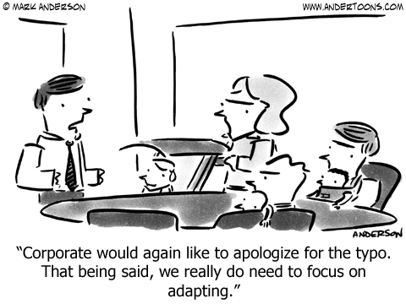

Slide 48
How to diagnose a problem with phoneme segmentation
Orally: The student cannot correctly identify the sounds (phonemes) in a CCVCC word (such as stunt, brisk, or clasp.
  Written: Students misspell a word by 1-2 letters; for example,
    jup for jump
    clas for clasp
    vast for fast

Slide 49
Teaching Phoneme Segmentation
I will tell you a word and I want you to tell me the sounds in it.
For example, if I say pat, you say /p…ă…t/.
If I say happy, you say /h…ă…p…ē/.
If I say bike, you say /__...__...__/.
If I say mule, you say /__...___...__/.

Slide 50
TPRI Resources for Phoneme Segmentation
Find blackline masters at www.tpri.org .
  PA-62: Segmenting Phonemes with Counters
  PA-63: Segmenting Phonemes with Pictures
  PA-64: Segmenting Memory
  PA-67: Move the Sounds

Slide 51
FCRR Resources for Phoneme Segmentation
Find activities at www.fcrr.org .
K/1
  PA.047: Treasure Chest (segmenting & blending)
  PA.048: Picture Slide (segmenting & blending)
  2/3
    PA.017 Phoneme Split and Say (segmenting & blending)—2-6 phonemes
    PA.018 Break and Make (segmenting & blending)—2-6 phonemes

Slide 52

PA Skills a Good Speller Needs
Phoneme manipulation, including
  phoneme addition
    ate late plate plate
      template contemplate
  phoneme deletion
    Pop-Tarts Tarts tart art
      Pop-Tarts op art

Slide 53
How to diagnose a problem with phoneme manipulation
Orally: student is SD on TPRI PA task 4 or 5; student cannot delete initial or final phoneme
  Written: student cannot generalize the spelling of a known word to a similar word which differs by one phoneme
    drink rink
    bowl bow (rainbow)

Slide 54
Teaching Phoneme Manipulation
Listen. The word is bark. What word?
  Students: bark
  What’s bark without the /k/?
  Students: bar
  What’s bark without the /b/?
  Students: ark
  Scaffold by doing the activity with letters, but then remove the scaffold and do the activity auditorily.
Use kinesthetic
scaffolds!

Slide 55
TPRI Resources for Phoneme Manipulation
Find blackline masters at www.tpri.org .
  PA-56: Initial Sound Elision with Pictures
  PA-58: Final Sound Elision with Pictures

Slide 56
FCRR Resources for Phoneme Manipulation
Find activities at www.fcrr.org .
K/1
  PA.049: Drop and Say
  PA.050: Name Changes (may be done on CD rather than cassette tape)
  2/3
  PA.019: What’s Left?

Slide 57
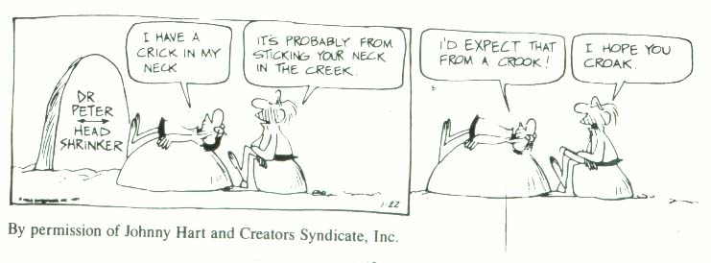
Why is it necessary for a good speller to be able to manipulate phonemes?
slkhs

Slide 58
What PA skill might not be mastered if a student….?
TPRI word | Student wrote | PA problem | GK problem
swim | swem | /ĭ/ ≠ /ĕ/
cent | sent |  | ce/se or meaning
jump | jmp | does not hear short vowel /ŭ/
clasp | casp | does not hear /l/ in blend
fast | faste |  | does not understand Vce pattern
shake | chak | /ch/ ≠ /sh/ | does not understand closed syllable/VCe
named | nam | does not hear ending (ed = /d/) | does not understand closed syllable/VCe

Slide 59
What PA skill might not be mastered if a student….?
HO 4
TPRI word | Student wrote | PA problem | GK problem
sweep | sweap
real | rele
mule | myul
bow | boe
spoon | soon
shore | chor
which | wich
new | noo
Work with a partner. Decide whether the mistake made by the student is related to PA or GK. Justify your answer.

Slide 60
Counting spelling errors
Traditional
  swem -1
  sent -1
  jmp -1 = -5 0/5 = 0
  casp -1
  faste -1
F

Slide 61
Counting spelling errors
Another option
  swim has 4 phonemes, so it has 4 spelling patterns—of those, the student missed only 1: /ĭ/ = i -1/4
  cent has 4 phonemes, so it has 4 spelling patterns—of those, the student missed only 1: /s/ = ce -1/4
  jump has 4 phonemes, so it has 4 spelling patterns—of those, the student missed only 1: /ŭ/ -1/4
  clasp has 5 phonemes, so it has 5 spelling patterns—of those, the student missed only 1: /l/ -1/5
  fast has 4 phonemes, so it has 4 spelling patterns—of those, the student missed only 1: /ă/ = a (not a_e) -1/4
  Student Score: -5, or 16/21 = 76% (C)

Slide 62
Counting spelling errors
HO 5
Calculate the student score for the following errors:
TPRI word | Student wrote | # spelling patterns | # errors | score
sweep | sweap
real | rele
mule | myul
bow | boe
spoon | soon
Total errors = ___ Total correct/total possible = ____

Slide 63
Discuss as a school/grade-level team
HO 6
Of the ideas discussed today, which do we want to apply to spelling instruction on our campus?
Using ONE of the ideas, plan for how this will be rolled out on your campus. Will additional training be needed? What is the proposed timetable for implementation?

Slide 64
References
Moats, Louisa Cook (2010). Speech to Print: Language Essentials for Teachers. Baltimore: Brookes Publishing Co.
Graphophonemic Knowledge: Routines and Teaching Tools. Children’s Learning Institute, UT Houston (2008).
PA…All Day! Children’s Learning Institute, UT Houston (2009).

Slide 65
