Slide 1

Phonological &
Phonemic Awareness
1
Notes:
Say: Welcome to today’s presentation, “Phonological and Phonemic Awareness.” Before we begin, let’s take care of a few housekeeping chores.
Introductions
Agenda, schedule for the day

Slide 2
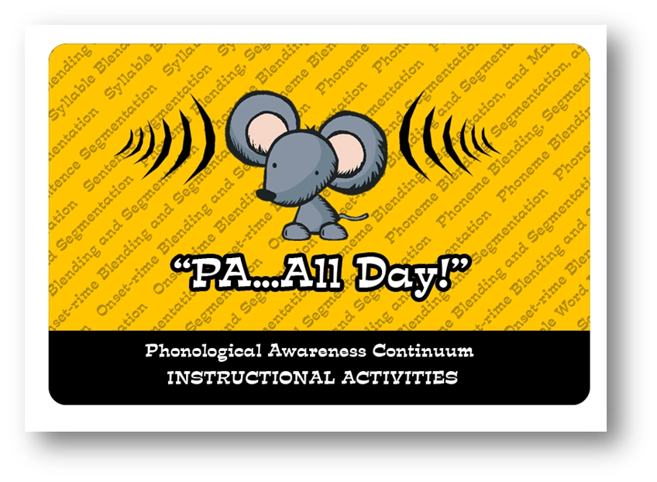
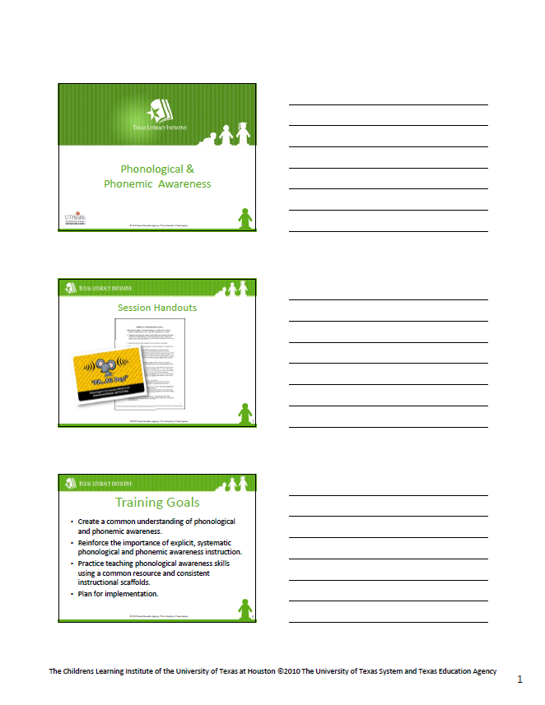
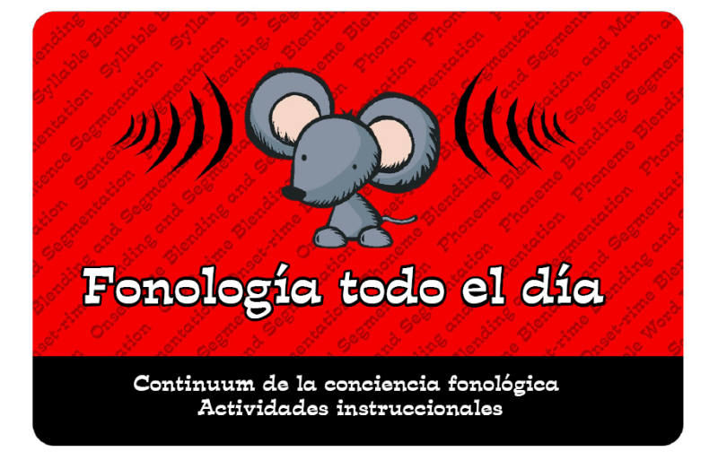
Session Handouts
Notes:
Here are all the items you will need for this session.
At your place setting you should find:
3-slides per page PowerPoint Handout
PA…All Day! book (in English or Spanish)

Slide 3
Training Goals
Create a common understanding of phonological and phonemic awareness.
Reinforce the importance of explicit, systematic phonological and phonemic awareness instruction.
Practice teaching phonological awareness skills using a common resource and consistent instructional scaffolds.
Plan for implementation.
Notes:
Say: Let’s look at our training goals for today’s session in phonological and phonemic awareness.
Read slide.

Slide 4
What is PA and Why is it so important?
Notes:
Read slide.

Slide 5
Phonological Awareness vs.
Phonemic Awareness
Phonological Awareness includes:
  Listening
  Rhyming / Alliteration
  Sentence Segmentation
  Syllable Blending and Segmentation
  Onset-Rime Blending and Segmentation
  Phoneme Blending, Segmentation and Manipulation
Notes:
Say: Before we talk specifically about Phonemic Awareness, let’s first clarify the difference between phonological and phonemic awareness.
Read slide.
Say: Phonemic Awareness is the most complex part of the Phonological Awareness continuum.

Slide 6

Phonemic Awareness is …
an awareness of individual sounds in spoken words.
an understanding that words are made
up of speech sounds, or phonemes.
the ability to identify and work with
the individual sounds in spoken words.
auditory, but should be connected
to print as soon as possible.
(Vaughn Gross Center for Reading and Language Arts, 2009.)
Notes:
Say: Phonemic Awareness focuses on the individual sounds in spoken language.
It is the understanding that words are made up of a combination of these speech sounds and the ability to identify each of the sounds (or phonemes) in a word.
At its highest level, phonemic awareness involves the ability to add or delete individual phonemes in words, and even substitute one phoneme for another in a word.
The skill itself is auditory, but needs to be connected to print as soon as possible so that students move toward the skill of connecting sounds and letters and ultimately to decoding.

Slide 7
Phonemic Awareness is Important
“One of the best predictors of how well students will learn to read during their first two years of school is phonemic awareness.” (Vaughn & Linan-Thompson, 2004, p. 9)
“Those with poor phonemic awareness skills at the end of their kindergarten year are more likely to become poor readers than those with well-developed phonemic awareness skills.” (Vaughn & Linan-Thompson, 2004, p. 9)
Notes:
Read slide.

Slide 8
Phonemic Awareness is Important
“Children who enter school with phonemic awareness have a very HIGH likelihood of learning to read successfully.
Children who lack phonemic awareness have a great deal of difficulty learning to read.
Obviously, children who come without phonemic awareness need to develop it! The question is not if but how.”
(Cunningham, 1999, p. 69)
Notes:
Say: To further emphasize the importance of phonemic awareness, Patricia Cunningham puts it this way…
Read slide.

Slide 9
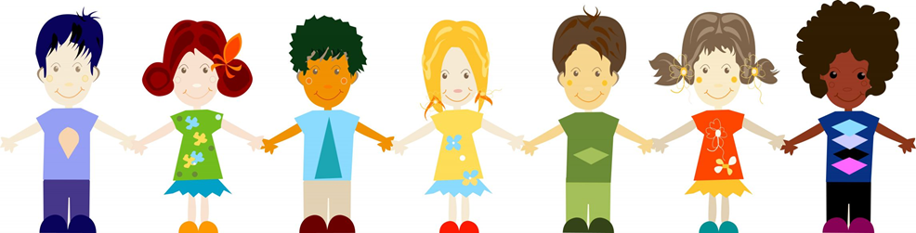
Instruction for All
Instruction in phonological and phonemic awareness helps ALL students learn to read, including…
Preschoolers
Kindergarteners
English Language Learners
Students with reading difficulties
Students with learning disabilities
All socioeconomic groups
Notes:
Say: The National Reading Panel Report in 2000 emphasized that this instruction is indeed appropriate for all students, including:
Read bullet points.

Slide 10
How Do we Effectively
Teach PA?
Notes:
Say: After hearing what the research says, we likely all agree that instruction in phonological and phonemic awareness is important. Let’s now think about how we effectively teach our Kindergarten, first, and second grade students PA skills.

Slide 11
Effective PA Instruction is…
Explicit and systematic, occurring every day for 10 to 15 minutes in K and beginning Grade 1.
Continued into the end of Grade 1 and beginning of Grade 2 if students have not mastered all skills.
Targeted, based on data.
Focused on 1-2 skills at a time for a period of time.
Notes:
Say: At its best, effective PA instruction is …
Read bullets.

Slide 12
Effective PA Instruction is…
Modeled by the teacher using consistent scaffolds to support student learning.
Interactive so that students have multiple opportunities to respond.
Most beneficial when taught in small groups.
Notes:
Say: At its best, effective PA instruction is …
Read bullets.

Slide 13
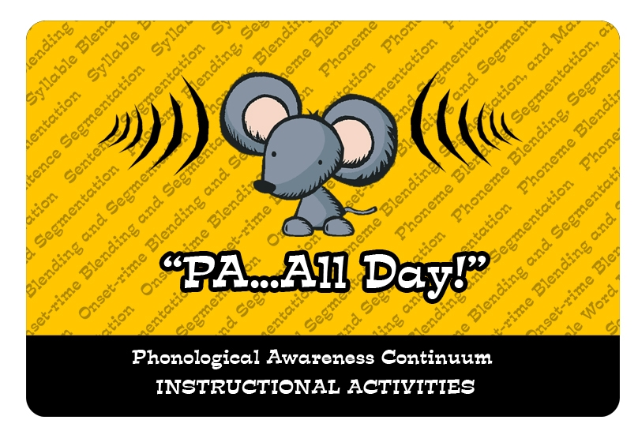


http://www.childrenslearninginstitute.org/ourprograms/programoverview/TX-readingfirst/resource-document-library.html
Notes:
Say: To help implement effective PA instruction across the district, we will refer to a common resource. This booklet, PA … All Day! was developed by the Children’s Learning Institute. It is available in both English and Spanish and can be downloaded for free by going to CLI’s website.
http://www.childrenslearninginstitute.org/our-programs/program-overview/TX-reading-first/resource-document-library.html
We will use this resource as part of our short-term plan for improving achievement in PA across the district.

Slide 14
Phonological Awareness Continuum
Phoneme Blending, Segmentation,
and Manipulation
Onset-Rime Blending
and Segmentation
Syllable Blending
and Segmentation
complex
Sentence
Segmentation
Rhyme/
Alliteration
Adapted from CIRCLE (National Head Start Literacy Train the Trainer Manual). (2002) UT Health Science Center at Houston.
Listening
simple
Notes:
Say: On page 8 of the English booklet, you will see a graphic of the Phonological Awareness Continuum. This continuum represents skills which are necessary for students to develop in order to ultimately become proficient in phoneme blending, segmentation, and manipulation.
Click. The continuum begins with skills that are considered simpler, including rhyming and alliteration, and progresses to more difficult tasks involving blending and segmentation of sentences, syllables, word parts, and – finally - phonemes.
While the arrow indicates the progression along the continuum, from simplest to most difficult, it is important to remember that students may need to loop back to previous steps along the continuum while developing phonological awareness.

Slide 15
Phonemes
Syllables
Sentences
Complex
Simple
Notes:
Say: It is also important to remember that there are varying levels of complexity within skills such as blending and segmenting. Always begin with the larger chunks of spoken language.
For example, it is simpler to segment a sentence into words than it is to segment a word into syllables, and it is easier to segment a word into syllables than into individual phonemes.

Slide 16
Phonological Awareness Continuum
Phoneme Blending, Segmentation,
and Manipulation
Onset-Rime Blending
and Segmentation
Syllable Blending
and Segmentation
complex
Sentence
Segmentation
Rhyme/
Alliteration
Adapted from CIRCLE (National Head Start Literacy Train the Trainer Manual). (2002) UT Health Science Center at Houston.
Listening
simple
Notes:
Say: We begin instruction with the easier skills along the Phonological Awareness continuum so that students can build a solid foundation before learning the critical skills at the phoneme level that are necessary for reading success.
Typically, when we look at the Phonological Awareness Continuum, the first phase is rhyme and alliteration. However, early childhood experts remind us that early learners, especially preschoolers and kindergartners, often need to have their listening skills developed before they can proceed along the PA continuum, which is why you see 'listening' at the base of our stairwell.

Slide 17
Listening
Sequencing sounds
clap, stomp, whisper. . .clap, stomp, whisper. . .
Reversal or substitution of words in nursery rhymes or familiar phrases
I love pizza…pizza love I
Brown bear, brown bear… Bear brown, bear brown
A series of verbal directions
Sit quietly, open your books, read softly
(Vaughn Gross Center for Reading and Language Arts, 2009.)
Notes:
Read Slide

Slide 18
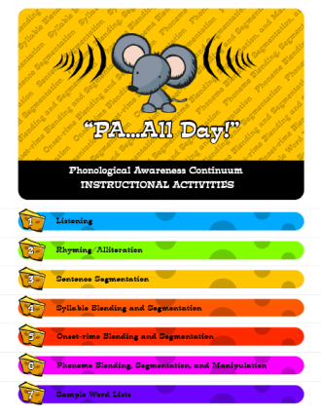
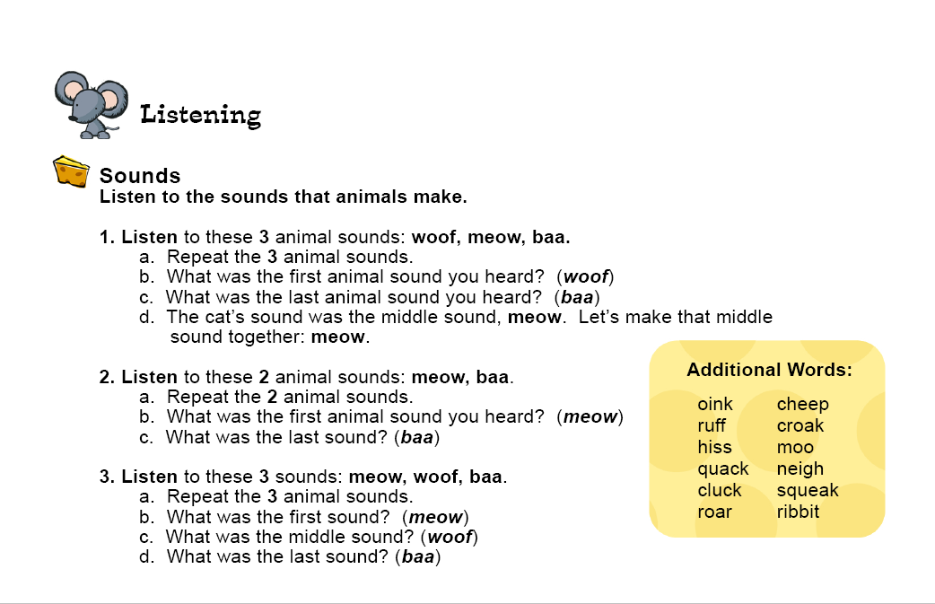
Notes:
Say: Look at tab 1 in “PA…All Day!” You will see some activities that can be used with students when building listening skills. I am going to model Activity #1 under “Sounds.” Please participate as if you were my students.
Model Activity #1 under “Sounds” (Listen to these 3 animal sounds: woof, meow, baa, etc.)

Slide 19
Phonological Awareness Continuum
Phoneme Blending, Segmentation,
and Manipulation
Onset-Rime Blending
and Segmentation
Syllable Blending
and Segmentation
complex
Sentence
Segmentation
Rhyme/
Alliteration
Adapted from CIRCLE (National Head Start Literacy Train the Trainer Manual). (2002) UT Health Science Center at Houston.
Listening
simple
Notes:
Say: After developing listening skills, the next step on the continuum is rhyming and alliteration.
Rhyming words are words that have matching ending sounds. The instructional activities for rhyme and alliteration activities are:
to direct students’ attention to the similarities and differences of the sounds of language
to use meaning and rhythm to predict rhyming words
to generate rhymes
to identify and generate alliterations
Keep in mind that it is important that children be exposed frequently and regularly to rhyme in order to develop familiarity with it. Once students are familiar with rhyme, they can practice identification—when given a pair of words, a student should be able to determine whether or not they rhyme. The most difficult rhyming activity is production. That is when a student is given one or more rhyming words and must produce an additional word—real or nonsense—that rhymes with the others. Remember that, when this skill is assessed on the TPRI, the student is given two rhyming words and must come up with a third word that rhymes with the other two. Practicing this format in the classroom will help ensure that students will be able to demonstrate the skill during the assessment.

Slide 20
Rhyming
Recite rhyming chants, songs, and finger plays.
Read nursery rhymes and other poems.
Tell stories with rhyming text.
Use word deletions during repeated readings.
(University of Texas Health Science Center at Houston, 2002)
Notes:
Read Slide

Slide 21
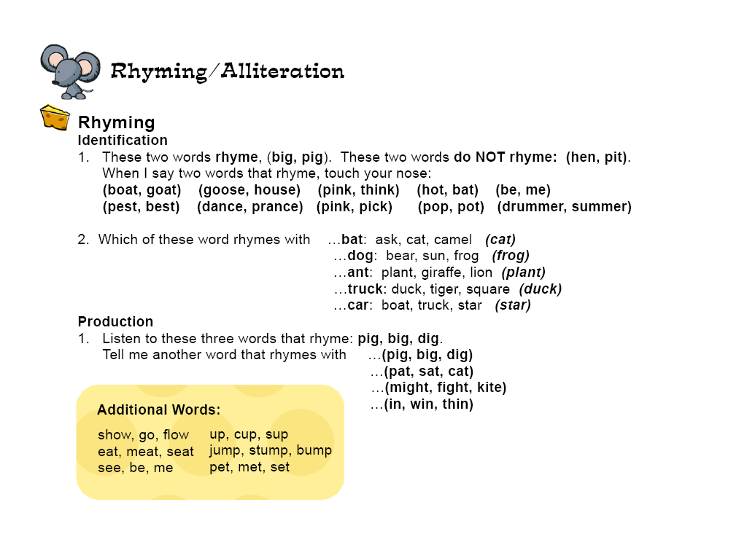
Notes:
Say: Look at tab 2 in “PA…All Day!” booklet. It contains activities for building rhyming and alliteration skills. I am going to model Activity #1 under “Rhyming.” Please participate as if you were my students.
Model Activity #1 under “Rhyming.”
Time permitting, model a “Production” activity as well.

Slide 22
Alliteration
Recite poems, chants, nursery rhymes, and songs with repeating initial sounds.
Call attention to words with similar beginning sounds.
Group objects by same beginning sounds.
Play beginning sound name games.
(Vaughn Gross Center for Reading and Language Arts, 2009.)
Notes:
Say: Alliteration is included on the PA continuum with rhyming. It focuses students’ attention on initial phonemes. Students not only learn to recognize words that begin with the same sound, but they also learn to produce words that begin with the same sound.

Slide 23
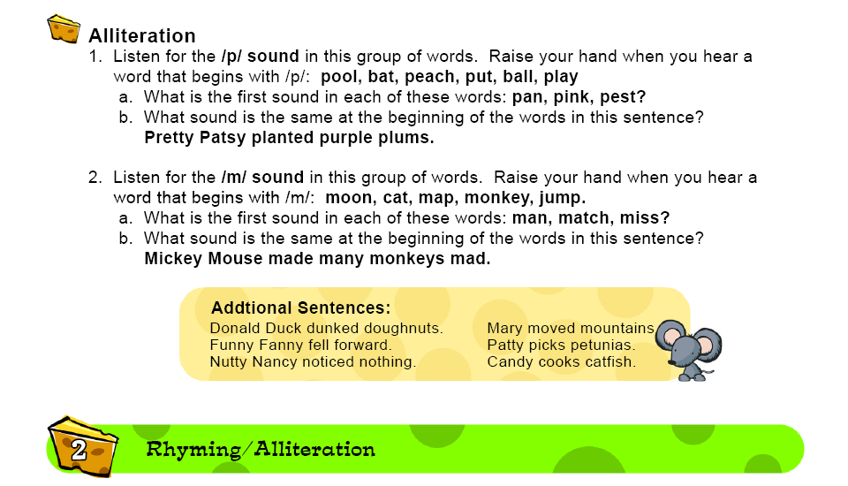
Notes:
Say: At the bottom of tab 2 in “PA…All Day!” are activities which can be used to build alliteration skills in students. I am going to model Activity #2. Please respond as if you were my students.
Model Activity #2 under “Alliteration.”

Slide 24
Phonological Awareness Continuum
Phoneme Blending, Segmentation,
and Manipulation
Onset-Rime Blending
and Segmentation
Syllable Blending
and Segmentation
complex
Sentence
Segmentation
Rhyme/
Alliteration
Adapted from CIRCLE (National Head Start Literacy Train the Trainer Manual). (2002) UT Health Science Center at Houston.
Listening
simple
Notes:
Say: Sentence segmentation is the next skill on the phonological awareness continuum.

Slide 25
Sentence Segmentation
The dog ran after the butterfly.
By segmenting the sentence into words, it becomes:
The
dog
ran
after
the
butterfly.
Notes:
Say: Many young children enter school with little knowledge about what is and is not a word. Sentence segmentation involves breaking a sentence down into its individual words which helps children realize that sentences are made up of separate words, and that words are spoken in a particular order so they make sense.
Click. Say each word as it appears on the slide: The – dog – ran – after – the – butterfly.

Slide 26
Sentence Segmentation
Teacher states a meaningful sentence from a book shared orally with the class.
    Students may respond by (clapping, stomping, raising their hand, touching their head) as they listen for each word in a sentence.
Teacher selects a sentence and assigns a different child to represent each word in the sentence.
    Students can arrange themselves in the appropriate order and link arms to make the sentence.
(University of Texas Health Science Center at Houston, 2002.)
Notes:
Say: Here are some example activities to help teach sentence segmentation. Sentence segmentation can be effectively practiced in any language.
Read slide.

Slide 27
Scaffold for Sentence Segmenting
Finger Counting
I teach at ...
Notes:
Say: When doing phonological and phonemic awareness activities, it is especially effective to use scaffolds. When the students no longer need the visual scaffold, the activity can be done in a purely auditory fashion.
Let’s practice one scaffold together that works well for sentence segmenting.
This scaffold is called Finger Counting. Extend your left arm, with your palm facing out. Make a fist, with your thumb pointing to the right. Starting with your thumb, count out the words in the sentence. Let me model for you and then you can try it.
Say, while modeling “finger counting”: My turn: “I – teach – at – Reading - Elementary.”
Say: Your turn, using the name of your school. Ready, begin “finger counting” the sentence, “I teach at ______ Elementary.”
Allow participants time to practice the scaffold.

Slide 28
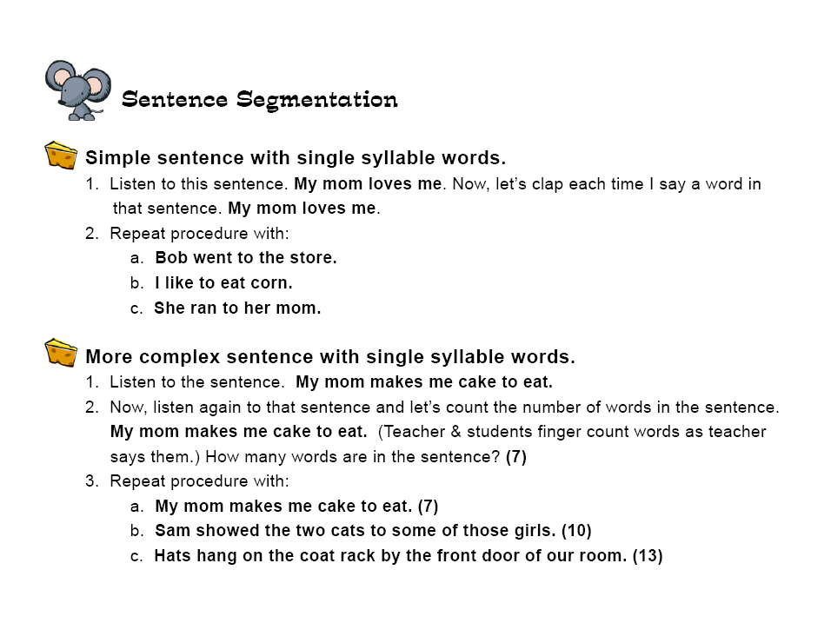
Notes:
Say: Now, let’s look at our “PA...All Day!” tab 3. It contains activities to help students build the skill of sentence segmentation. Listen as I model the first activity. Respond as if you were my students.
Model Activity #1 under “Simple sentence with single syllable words.”
Say: Your turn. With your partner, take turns modeling Sentence Segmentation Activity #2: “More complex sentence with single syllable words,” using the Finger Counting scaffold.

Slide 29
Phoneme Blending, Segmentation,
and Manipulation
Phonological Awareness Continuum
Onset-Rime Blending
and Segmentation
Syllable Blending
and Segmentation
complex
Sentence
Segmentation
Rhyme/
Alliteration
Adapted from CIRCLE (National Head Start Literacy Train the Trainer Manual). (2002) UT Health Science Center at Houston.
Listening
simple
Notes:
Say: The next step on the continuum is syllable blending and segmentation.

Slide 30
The dog ran after the butterfly.
Example of segmenting into syllables:
/af /
/ter/
Example of segmenting a compound word:
/butter/
/fly/
Notes:
Say: Segmenting syllables involves taking one word and breaking it into syllables.
Click. Say: For example, in the sentence, “The dog ran after the butterfly,” the word after would be segmented this way:
Click. Say: af ter
Click. Say: If you have a student who is having difficulty segmenting a word into syllables, scaffold back to segmenting compound words.
Click. Say: For example, in this sentence, the word butterfly could be broken apart this way:
Click. Say: butter fly

Slide 31


Scaffolds for Syllable Blending And Segmenting
Palms up
ta▪ble, bas▪ket
              Arm blending
pro▪fes▪sion▪al, chry▪san▪the▪mum
Cutting Board & Scissors
cur▪rent▪ly, fan·tas·tic
Notes:
Say: There are two scaffolds that work well to help visually and physically demonstrate the auditory task of blending syllables.
Say: “Palms up” is a scaffold that can be used with two-part blends - for example, a compound word with two base words, or a word with two syllables. It also works well for demonstrating onset-rime and deletion of initial or final phonemes in words. For this scaffold, begin with the right hand (so that you demonstrate a left-to-right progression of sounds for the students). Extend the right hand, palm up, as you say the first word part; then, extend the left hand, palm up, as you say the second word part. Bring the palms (or sides of the palms) together as you blend the word.
For example: “cart” (extend right hand, palm up) “wheel” (extend left hand, palm up) “cartwheel” (touch sides of palms together).
Click. Say: Your turn! Take turns with your partner modeling the “Palms up” scaffold with these two-syllable words.
Give participants a minute to practice “Palms up.” Check for accuracy.
Click. Say: Arm blending is a scaffold that can be used with any multisyllabic word, but works best with three-, four-, or five-syllable words. Extend your left arm. Using your right hand, touch your shoulder for the first syllable, elbow for the second syllable, and wrist for the third syllable, then sweep your right hand under your left arm from shoulder to wrist to demonstrate blending the syllables back together to make a word. For a four- or five-syllable word, add touch points between the shoulder and wrist.
For example, “development” would be “de” (touch shoulder) “vel” (touch upper arm) “op” (touch forearm) “ment” (touch wrist). “Development.” (Sweep right hand under left arm, shoulder to wrist.)
Click. Say: Your turn! Take turns with your partner modeling the “Arm blending” scaffold with these four-syllable words.
Click. Say: “Cutting Board and Scissors” can be used when segmenting syllables. Beginning with your left arm extended and your right hand resting on the left arm. Count out the syllables in the word with the fingers on your right hand. You can also use the touch points like we did in “Arm Blending” if you prefer.
For example: “professor” would become “prof” (extend index finger) “fes” (extend middle finger) “sor” (extend ring finger).
Click. Say: Your turn! Take turns with your partner modeling the “Cutting Board and Scissors” scaffold with these three-syllable words.

Slide 32
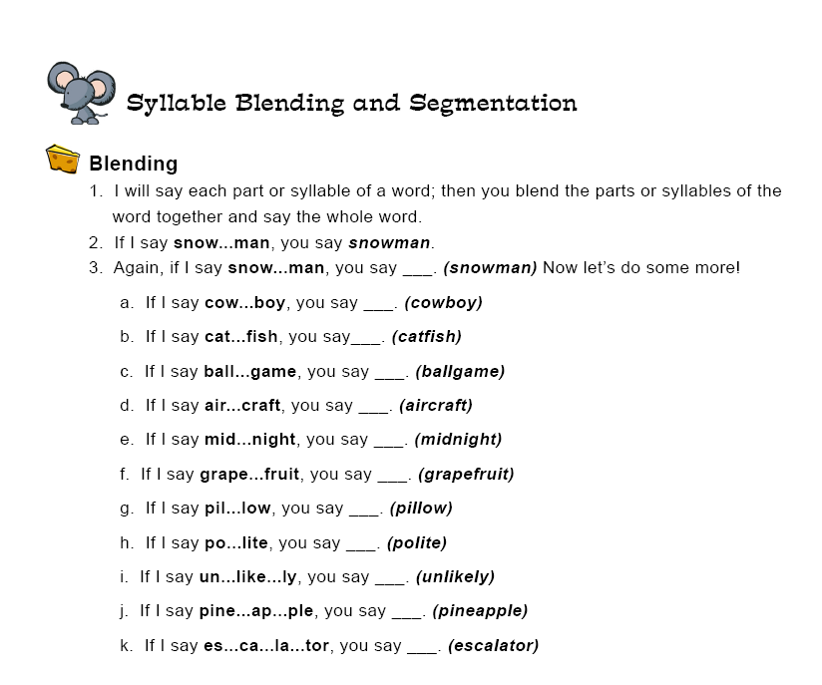
Notes:
Say: The next tab on your “PA...All Day!” is number 4, and represents syllable blending and segmentation. Please turn there now.
Listen and participate as I model the first one for you. I will say each part or syllable of a word; then you blend the parts or syllables of the word together and say the whole word. Notice that I am going to use the “Palms Up” scaffold. Remember, you can use this scaffold when blending and segmenting two-syllable words. For words with more syllables, you could use “Arm Blending.”
(Model two or three examples from the page, using the “Palms Up” scaffold.)
Say: Now, take turns with your partner demonstrating blending two-syllable words. If you want to attempt the three and four syllable words at the bottom, remember to change to “Arm Blending.”
(Allow time for participants to practice.)

Slide 33
Phonological Awareness Continuum
Phoneme Blending, Segmentation,
and Manipulation
Onset-Rime Blending
and Segmentation
Syllable Blending
and Segmentation
complex
Sentence
Segmentation
Rhyme/
Alliteration
Adapted from CIRCLE (National Head Start Literacy Train the Trainer Manual). (2002) UT Health Science Center at Houston.
Listening
simple
Notes:
Click. Say: The next level of phonological awareness on the continuum is onset-rime blending and segmentation.

Slide 34
Onset and Rime Instruction
Will help preschoolers & kindergartners:
focus attention on a smaller unit of sound-the onset or initial sound(s) in a word.
focus on hearing sounds in sequence and blending them together to make a word.
d – og pl – ay spl – ash
(Vaughn & Linan-Thompson, 2004.)
Notes:
Say: Onset and rime occur in single syllable words. An onset is all the sounds in a single-syllable word that come before the first vowel. For instance, in the word “dog,” /d/ is the onset and /og/ is the rime. However, in the next word, “play,” there is a consonant blend that comes before the first vowel. Therefore, it is the blend, /pl/, that is the onset, and /ay/ is the rime. In a word with a three-consonant blend, such as “splash,” the entire blend is considered to be the onset. Therefore, in the word “splash,” /spl/ is the onset, and /ash/ is the rime.
Be aware, however, that it is still important to take the blends down to a phoneme level. In certain curricula, as well as on the TPRI assessment, students need to be able to separate and manipulate the phonemes in blends. For example, “What’s ‘trash’ without the /t/?” “Rash.”

Slide 35

Scaffold for Onset-Rime
Segmenting and Blending
Palms up
ball = /b/ + /all/
house = /h/ + /ouse/
clam = /cl/ + /am/
branch = /br/ + /anch/
strong = /str/ + /ong/
through = /thr/ + /ough/
Notes:
Say: These are a few ways to scaffold onset and rime.
Click. Say: The “Palms up” scaffold is good to use for onset-rime blending and segmentation, since there are only two parts involved.
Say: Some examples include:
lake = /l/ + /ake/
break = /br/ + /eak/
streak = /str/ + /eak/
Your turn! With a partner, practice using the “Palms up” scaffold for blending and segmenting these words.

Slide 36
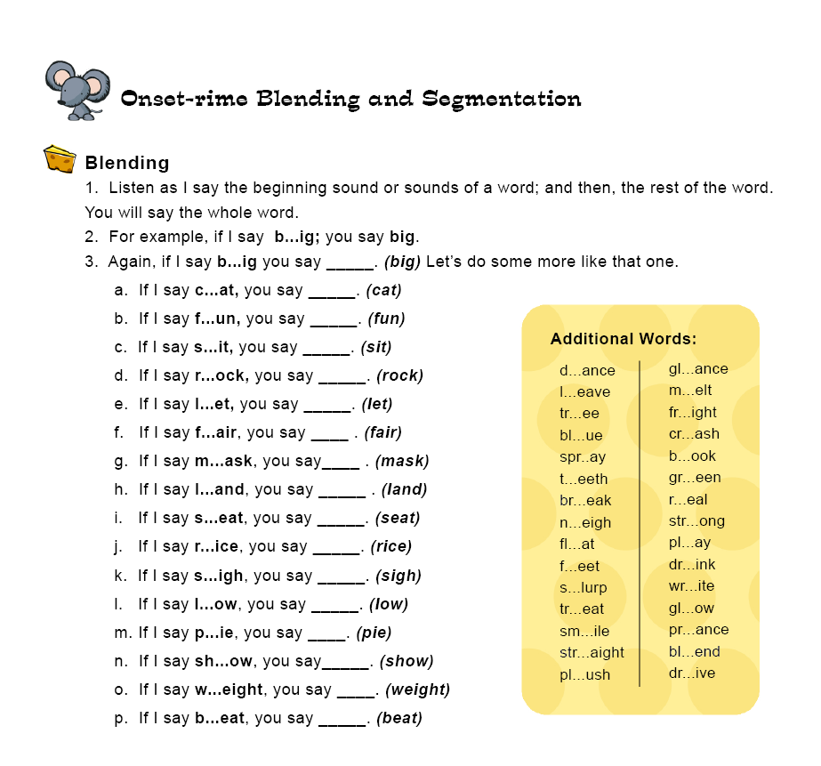
Notes:
Say: “PA…All Day!” suggests some words which can give students practice with blending onsets and rimes. Look at tab 5. Listen and participate as I model the first one for you. Turn to the red tab, labeled “Onset-rime Blending And Segmentation.”
(Read the first 3 lines under “Blending” and then model the first example. Be sure to adequately separate the initial sound [onset] from the rest of the word [rime], and utilize the “Palms Up” scaffold.)
Say: Again, it’s your turn. Take turns with your partner. Model the rest of the examples. Remember to use the “Palms Up” scaffold.
(Allow time for participants to complete the activity.)

Slide 37
Phonological Awareness Continuum
Phoneme Blending, Segmentation,
and Manipulation
Onset-Rime Blending
and Segmentation
Syllable Blending
and Segmentation
complex
Sentence
Segmentation
Rhyme/
Alliteration
Adapted from CIRCLE (National Head Start Literacy Train the Trainer Manual). (2002) UT Health Science Center at Houston.
Listening
simple
Notes:
Say: The most difficult set of phonological awareness skills consists of phoneme blending, segmentation, and manipulation. When this level of phonological awareness has been reached, and the sounds that are being identified, blended, segmented, and manipulated are at the phoneme level—the smallest unit of sound in spoken language—we refer to it as phonemic awareness.

Slide 38
Phonemes
Phonemes: the smallest units of sound in spoken words.
/r/ /a/ /t/
1st phoneme 2nd phoneme 3rd phoneme
/sh/ /ā/ /k/
1st phoneme 2nd phoneme 3rd phoneme
/l/ /a/ /s/ /t/
1st phoneme 2nd phoneme 3rd phoneme 4th phoneme
Notes:
Say: When words are spoken, phonemes, or individual sounds, are blended together. In written words, phonemes may be represented by single letters or combinations of letters.
Click. Say: The word “rat” has 3 letters and 3 phonemes.
Click. Say: The word “shake” has 4 letters and 3 phonemes.
Click. Say: The word “lass” has 4 letters and 3 phonemes.
Notice that, in the words “shake” and “lass,” there are fewer sounds in the words than there are letters. As students begin to learn variant spelling rules for phonemes in words, they will learn that one sound can be represented by one or more letters.

Slide 39
Scaffold for Phoneme Blending
/r/ /a/ /t/
/sh/ /ā/ /k/
/l/ /a/ /s/ /t/
Notes:
Say: A scaffold that works well for segmenting and blending phonemes is “Head, Shoulders, Knees, and Toes.
For example, to segment the word rat: /r/ (touch head) /a/ (touch shoulders) /t/ (touch knees).
To blend, we simply run the hands quickly from the head down to the knees while blending the sounds together. (Model blending rat.)
Now it’s your turn. Practice segmenting and blending phonemes for the two words on the screen.
If you have a word that has more phonemes, you can always include your hips as well.

Slide 40
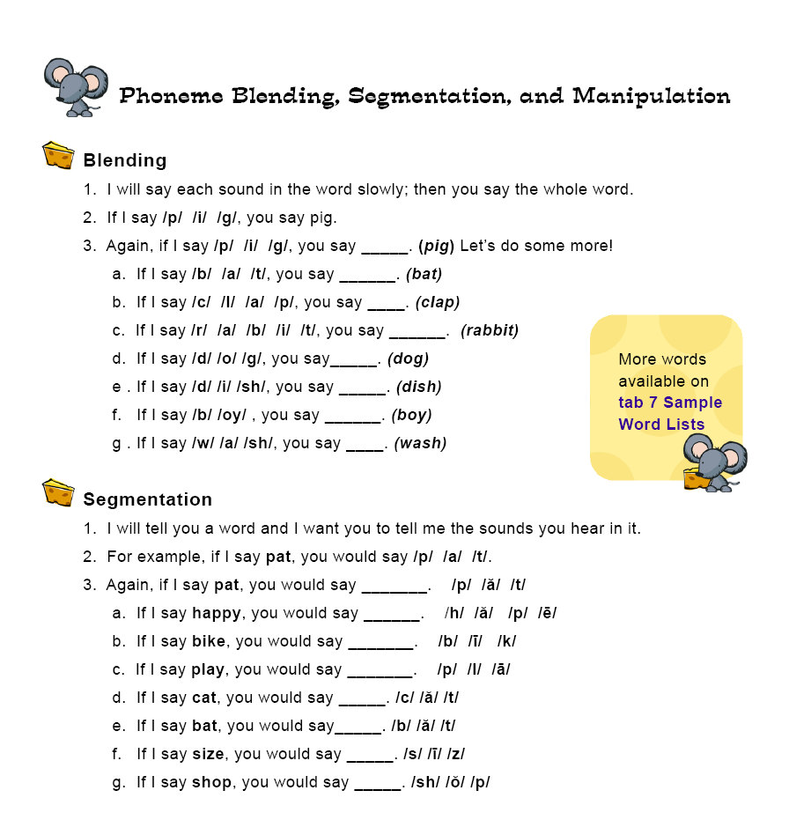
Notes:
Say: On tab 6 in “PA…All Day!”, it suggest some words which can give students practice in blending and segmenting phonemes. On the bottom page, you’ll notice a section dedicated to Phoneme Manipulation. Let’s turn our attention to that skill now.

Slide 41
The most challenging PA task is
phoneme manipulation.
Adding a phoneme = least difficult
Deleting a phoneme = difficult
Substituting a phoneme = most difficult
Notes:
Read Slide

Slide 42
Phoneme Manipulation
Adding, deleting, or substituting phonemes in words requires the most developed phonemic awareness skills.
Examples:
What word do you make if you. . .
add /n/ to ice?
delete /k/ from cape?
substitute the /h/ in hat with /p/?
(Vaughn & Linan-Thompson, 2004.)
Notes:
Read slide and model the examples.
Say: Let’s focus on deleting phonemes as an example of how we might teach phoneme manipulation to students.

Slide 43
Start by teaching students to manipulate compound words, then introduce syllable manipulation, then phoneme manipulation.
Scaffold: Palms Up!
/cow/ /boy/
“What is cowboy without the boy?”
/c/ /ape/
“What is cape without the /k/?”
Notes:
Read slide.
Say: Using the “Palms Up!” scaffold works well for demonstrating the deletion of initial and final phonemes. Follow along as I model it for you.
Begin with the right hand (so that you demonstrate a left-to-right progression of sounds for the students). Extend the right hand, palm up, as you say the first word part; then, extend the left hand, palm up, as you say the second word part. Bring the palms (or sides of the palms) together as you blend the word. (Do each motion as you describe it.)
Say: For example, “cart” (extend right hand, palm up) “wheel” (extend left hand, palm up) “cartwheel” (touch sides of palms together).
Say: Now, To demonstrate deletion of the beginning word part, ask, “What’s ‘cartwheel’ without the ‘cart’?” Bring your right hand behind your back. Put both palms out again, then ask, “What’s ‘cartwheel’ without the ‘wheel’?” Bring your left hand behind your back. (Do each motion as you describe it.)
Continue to demonstrate this procedure using the words “cowboy” and “cape.”

Slide 44
Phoneme Deletion
Your turn!
mask without the /m/; without the /k/
part without the /p/; without the /t/
(Vaughn & Linan-Thompson, 2004.)
Notes:
Say: Now it’s your turn! Using the “Palms up” scaffold, demonstrate for your partner how to delete the initial and final phonemes of each of these words.
Allow participants time to complete this activity.

Slide 45

Video: Overview of
Phonological Awareness
As you watch the video, note
examples of each of the steps in
the Phonological Awareness Continuum.
Notes:
Say: Now that we’ve explored the phonological awareness continuum, and have seen the progression from phonological skills to phonemic skills, we’re going to watch a short video demonstrating actual classroom instruction in phonological awareness.
As you watch the following video, note examples you see of each of the steps in the Phonological Awareness Continuum. Also note, how effectively the teacher teaches PA to her students. This is the kind of instruction we all want to strive for in our classrooms.
Take time to debrief and discuss after watching the video.

Slide 46
Phonological or Phonemic Awareness?
Give me a word that rhymes with cat.
/dog/ /house/ What’s the word?
/d/ /o/ /g/ What’s the word?
Peter Piper picked a peck of pickled peppers.
What’s “nice” without the /n/?
Notes:
NOTE: Discuss each phrase and where it falls on the Phonemic Awareness Continuum. Address any misunderstandings. Discuss each phrase and where it falls on the Phonemic Awareness Continuum. Address any misunderstandings.
Say: We’re going to do a little review. You will see a phrase related to either a general phonological awareness activity or specifically to a phonemic awareness activity. Read the phrase. If you think it represents a phonemic awareness activity, give me a thumbs-up signal. If you think it represents a phonological awareness activity, give me a thumbs-down signal.
Click: If I say give me a word that rhymes with cat. (thumbs down--phonological awareness—rhyming)
Click: If I say /dog/ /house/ What is the word? (thumbs down—phonological awareness—blending word parts or compound words)
Click: If I say /d/ /o/ /g/ What is the word? (thumbs up—phonemic awareness—phoneme blending)
Click: If I say Peter Piper picked a peck of pickled peppers. (thumbs down—phonological awareness--alliteration)
Click: If I say what is “nice” without the /n/? (thumbs up—phonemic awareness—initial phoneme deletion)

Slide 47
Reminders …
Begin with phonological awareness; progress to phonemic awareness.
Proceed from less difficult to more difficult tasks.
Use data (from both formal and informal assessments) to determine the PA skills students need to develop or master.
Explicit instruction with teacher modeling and multiple opportunities for independent practice
(Bos & Vaughn (2002) and Smith, Simmons, & Kame’enui (1998) in Vaughn & Linan-Thompson, 2004.)
Notes:
Say: In summary, instruction in PA should begin with phonological awareness skills and progress, as students are ready, to the more complex phonemic awareness skills. Within each step of the continuum, remember to begin with the less difficult tasks, provide scaffolding, and slowly work your way towards more complex tasks.
Teachers should rely on data to determine which skills students need to learn and which ones they have already mastered and may only require occasional review.
Instruction in both phonological and phonemic awareness needs to be explicit, meaning that the teacher needs to model each skill for the students, usually many times, then give the students support as they attempt to demonstrate the skill.
Finally, students need to have ample opportunity to do the activities independently in order to achieve mastery.

Slide 48
Reminders …
Use manipulatives, body movements, or fingers to make auditory tasks more visible to students.
Provide positive & corrective feedback with multiple opportunities for practice and review.
Connect PA instruction to print ASAP.
(Bos & Vaughn (2002) and Smith, Simmons, & Kame’enui (1998) in Vaughn & Linan-Thompson, 2004.)
Notes:
Read slide.

Slide 49
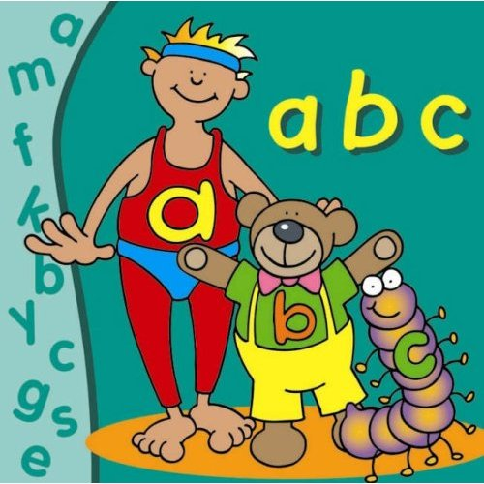
Make Phonological and
Phonemic Awareness Lessons…
purposeful
fun
short & sweet
frequent
Notes:
Read slide.

Slide 50
Planning for Implementation
Notes:
Say: Now that we have discussed Phonological and Phonemic Awareness instruction, let’s take some time to talk about how we will implement consistent, strong PA instruction in our schools.

Slide 51
Next Steps
Middle-of-Year TPRI administration (MOY)
Grade level data meetings to analyze data and plan targeted instruction
Link to IAG and FCRR
Sharing information with other staff members

Slide 52
Guiding Questions
With which staff members will you share this information?
How will you share this information with identified staff?
Who will be responsible for training other staff members and creating the necessary materials?
When will training occur?
Who will follow-up?
How will progress be monitored?
Notes:
Provide time for discussion.

Slide 53
/th/ /a/ /ng/ /k/ /y/ /oo/
/f/ /or/ /y/ /oo/ /r/
/p/ /ar/ /t/ /i/ /s/ /u/ /p/ /ā/ /sh/ /u/ /n/
Thank you
for your
participation!
Notes:
Click to start the title lines.
Say: Thank you for your participation!

Slide 54
References
Cunningham, P. M. (1999). Phonics thy use: Words for reading and writing (3rd ed.). Boston, MA: Addison-Wesley.
The Children’s Learning Institute, (2009). From Phonological to Phonemic. Houston, TX: University of Texas Health Science Center at Houston, The University of Texas System & Texas Education Agency.
The Children’s Learning Institute, (2009). PA … All Day! Houston, TX: University of Texas Health Science Center at Houston, The University of Texas System & Texas Education Agency.
University of Texas Health Science Center at Houston, (2002). CIRCLE: National Head Start Literacy: Train the trainer manual. Houston, TX: Author.
Vaughn Gross Center for Reading and Language Arts, (2009). Kindergarten teacher reading academy, Austin, TX: Author
Vaughn, S., & Linan-Thompson, S. (2004). Research-based methods of reading instruction, grades K-3. Alexandria, VA: ASCD.
.

